Slide 1

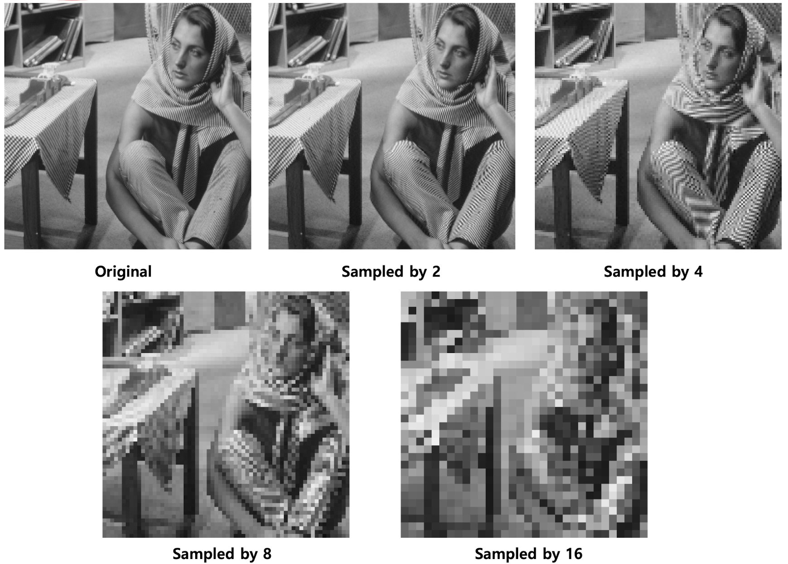
High Freq.
Low Freq.

Slide 2
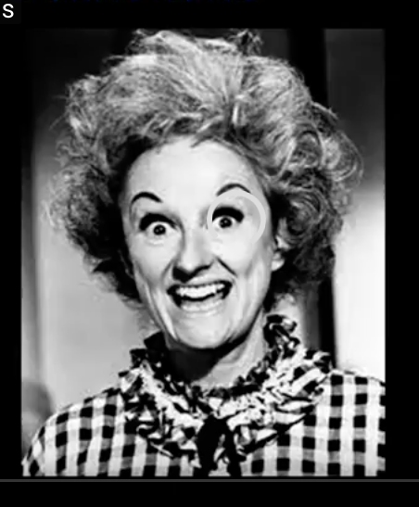
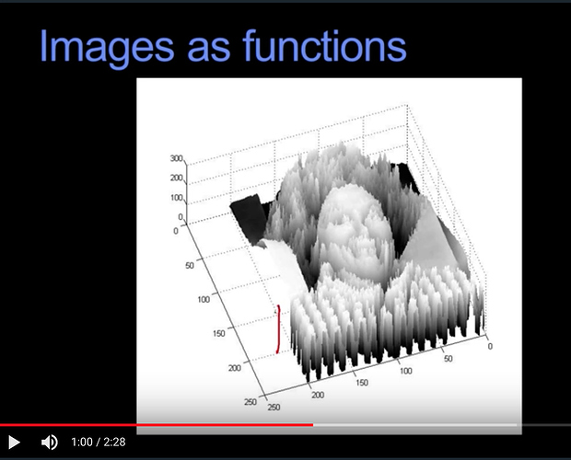
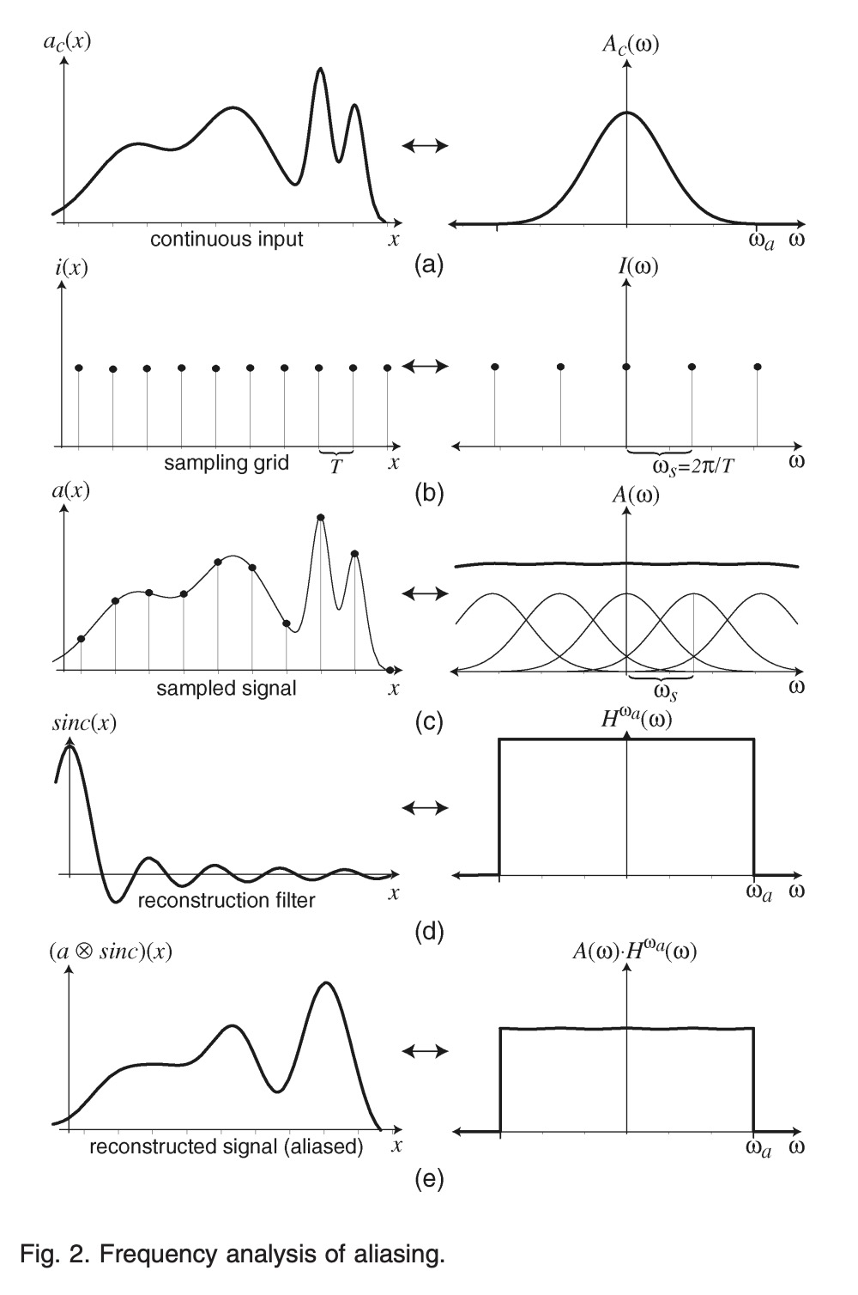
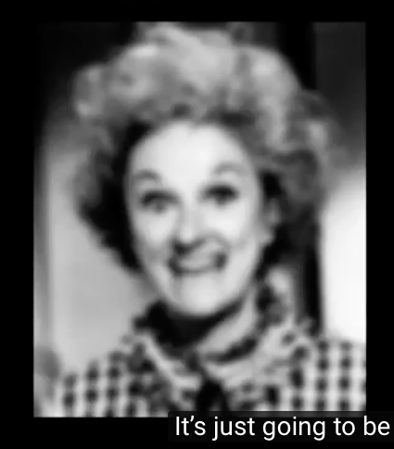
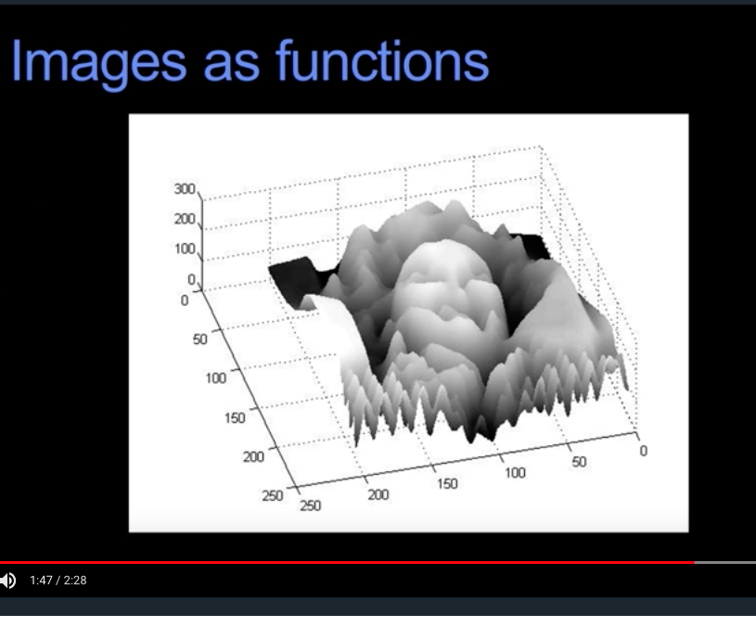



Image
Spatial Domain
Frequency Domain
(a)
Target
$$≡$$
(b)
$$≡$$
Input
(c)
$$≡$$
(d)
$$≡$$
Recon. Filter
(e)
Output
$$≡$$
Notes:
C

Slide 3


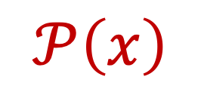
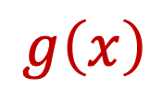
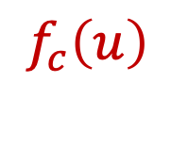

$$ρ$$
$$φ$$
Out of scope
$$f_{c}\left(u\right)$$
$$𝒫\left(x\right)$$
$$g\left(x\right)$$

Slide 4
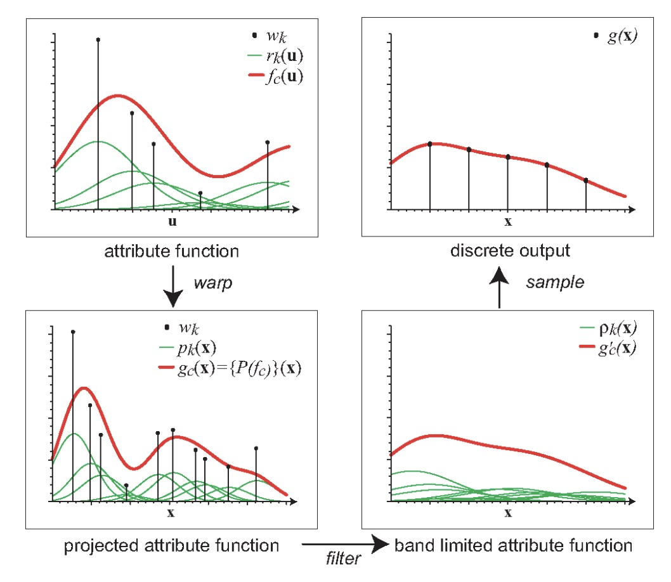

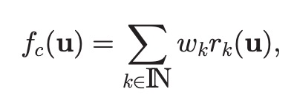

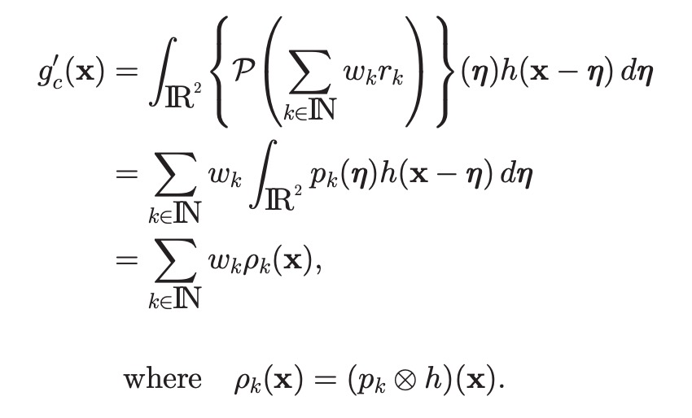



Slide 5
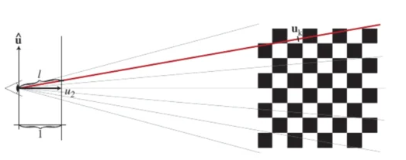
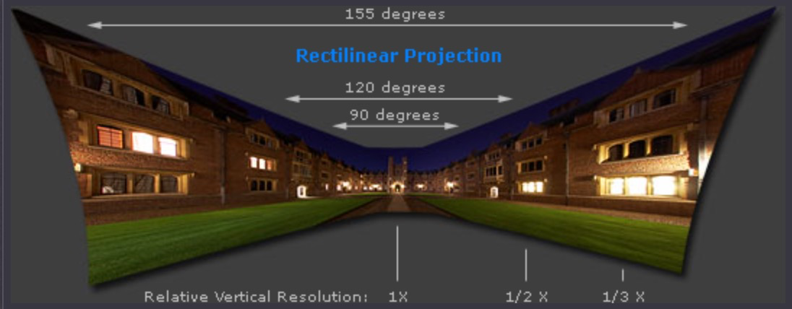






$$u$$
$$θ$$
$$⋯$$
$$f$$
$$u=f tan\left(θ\right)$$
$$u_{2}=tan\left(θ\right)$$

Slide 6

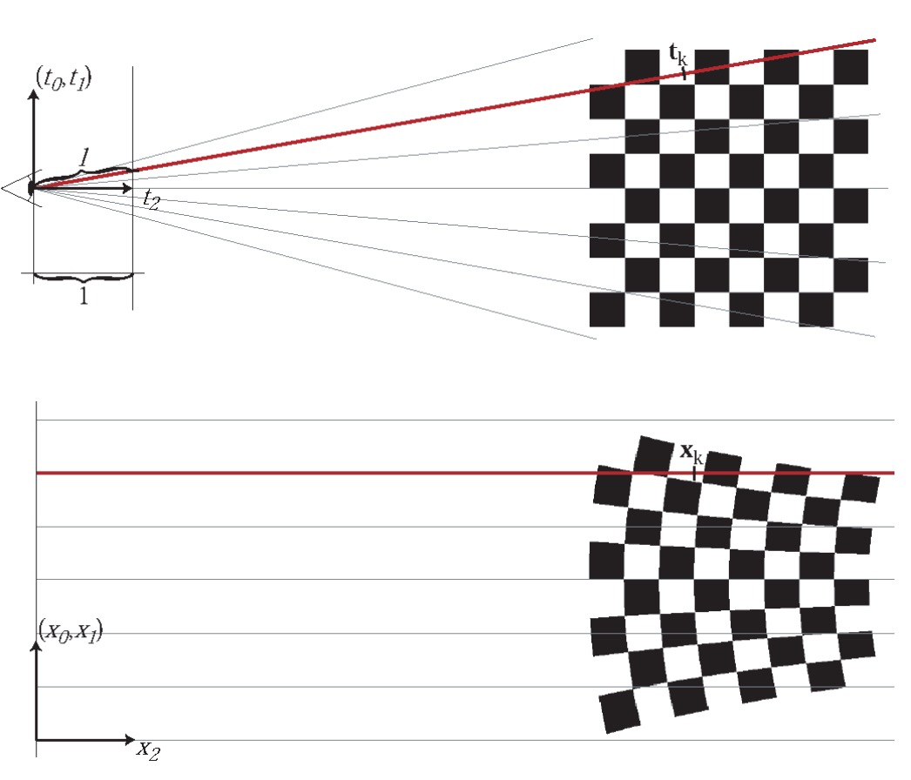
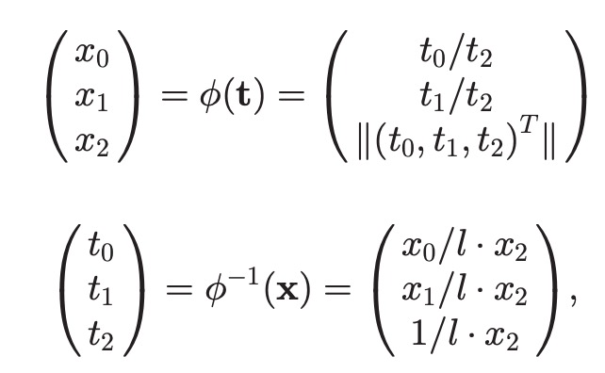

Slide 7
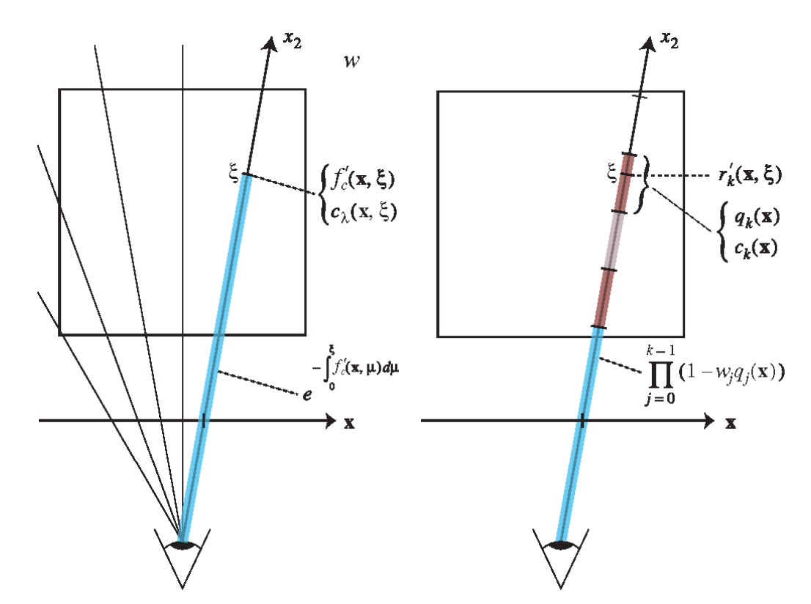
Ray Space
Ray Space
Screen Space
Screen Space
Volume Rendering
Splatting

Slide 8
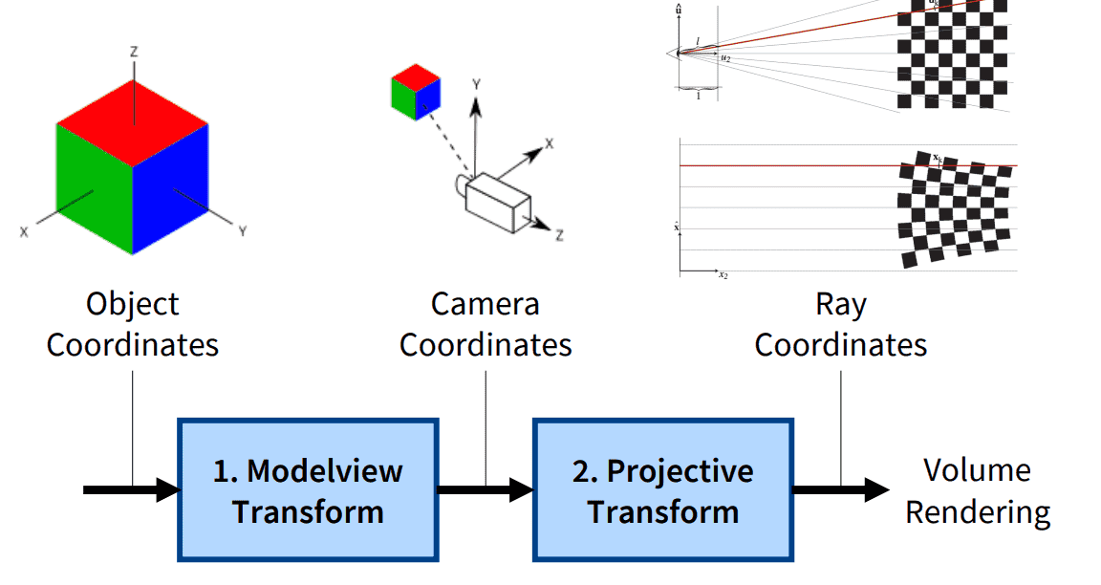
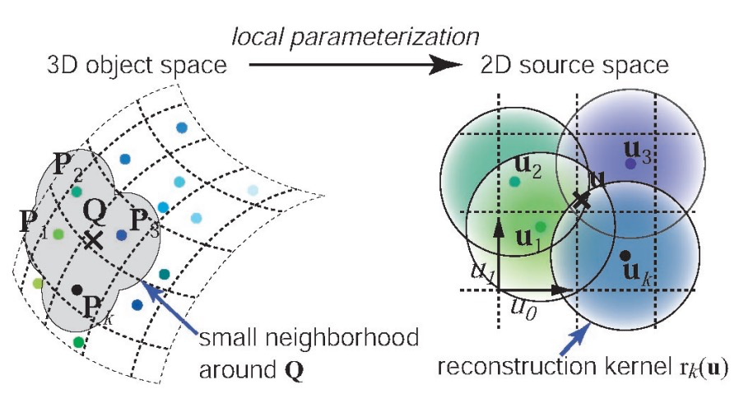







Ray Space
World Coordinate
Object
Coordinate
$$ρ_{k}(x)$$
$$ρ$$
$$φ$$
$$m\left(u\right)=φ\left(ρ\left(u\right)\right)$$
$$→projected gaussian dist.$$
$$→constant$$
$$≈o_{k}→constant$$
Screen Space
Splatting

Slide 9
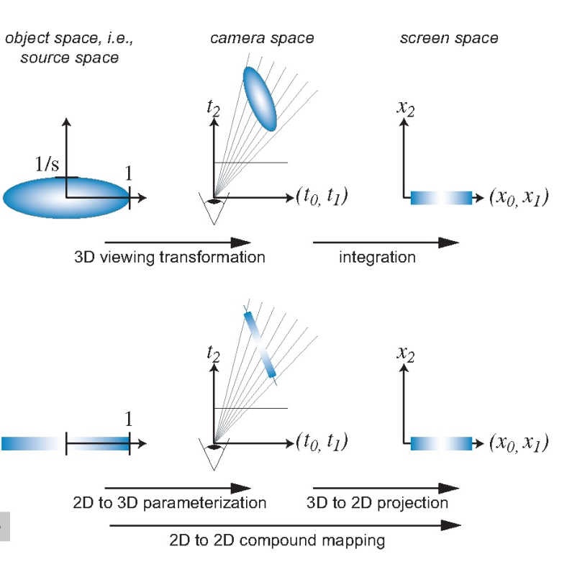
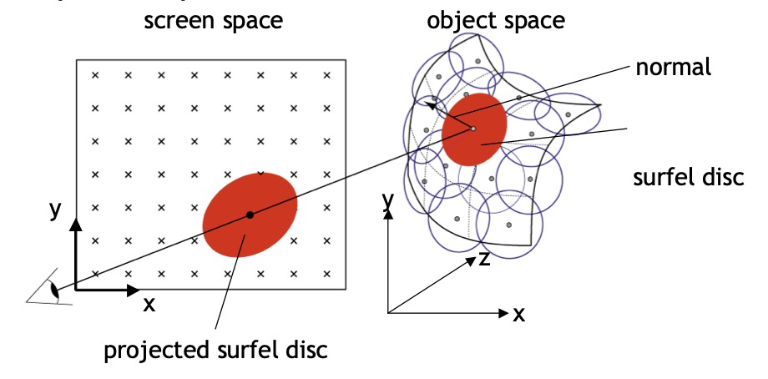
(Sec 3.1.)
Volume sampling
(Sec 3.2.)
Surface sampling

Slide 10
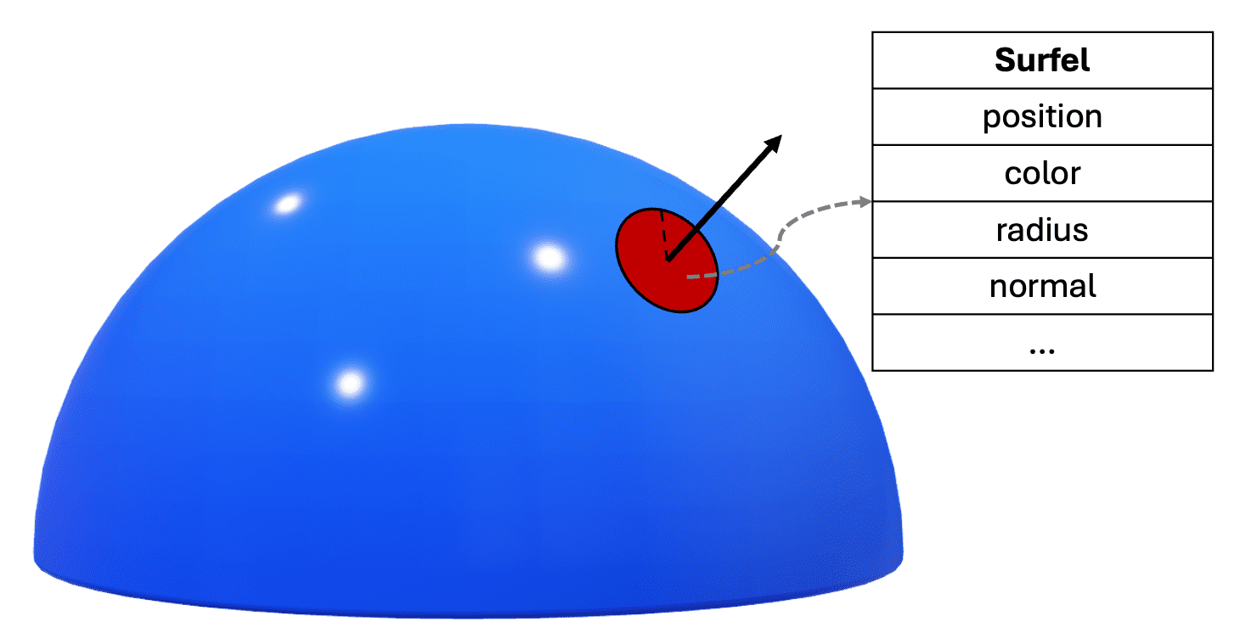
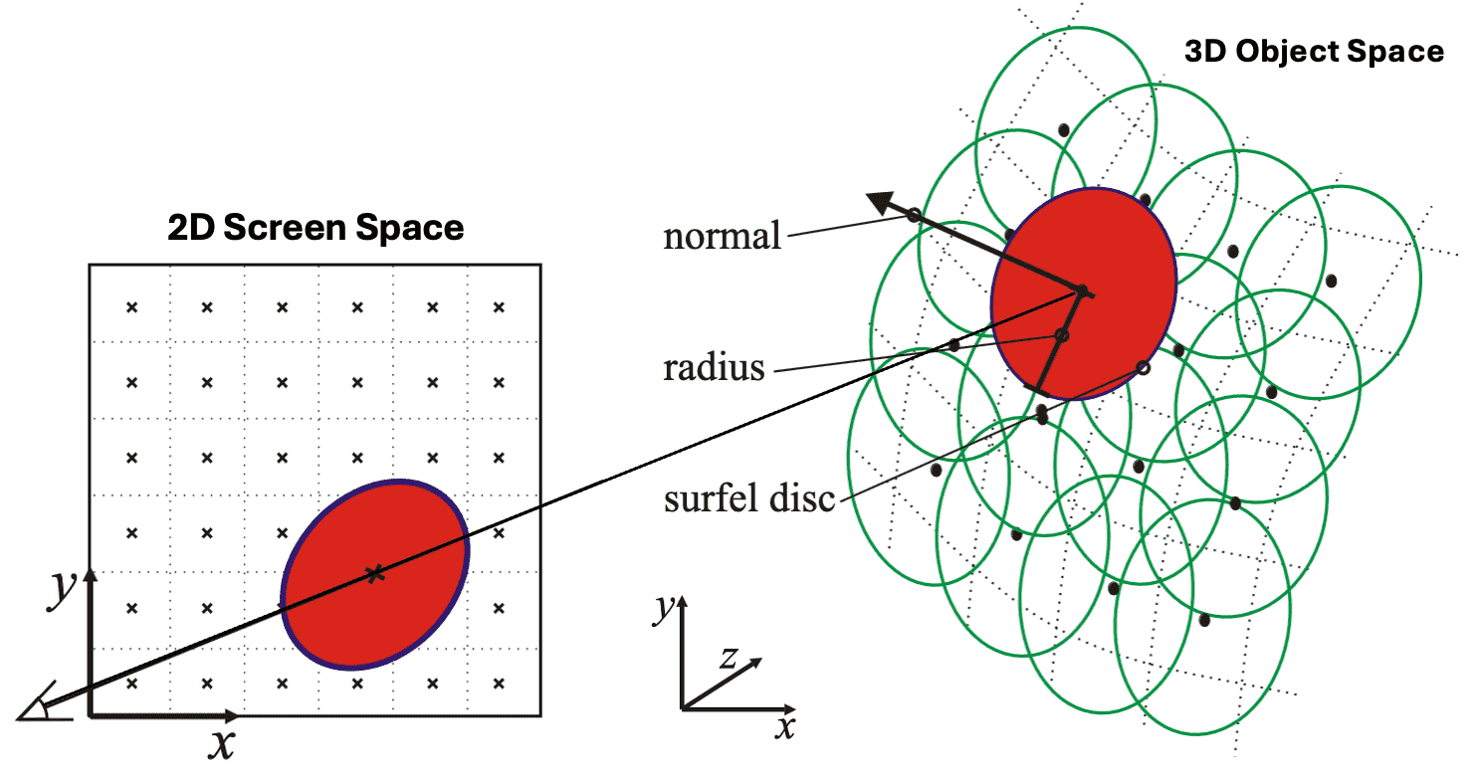
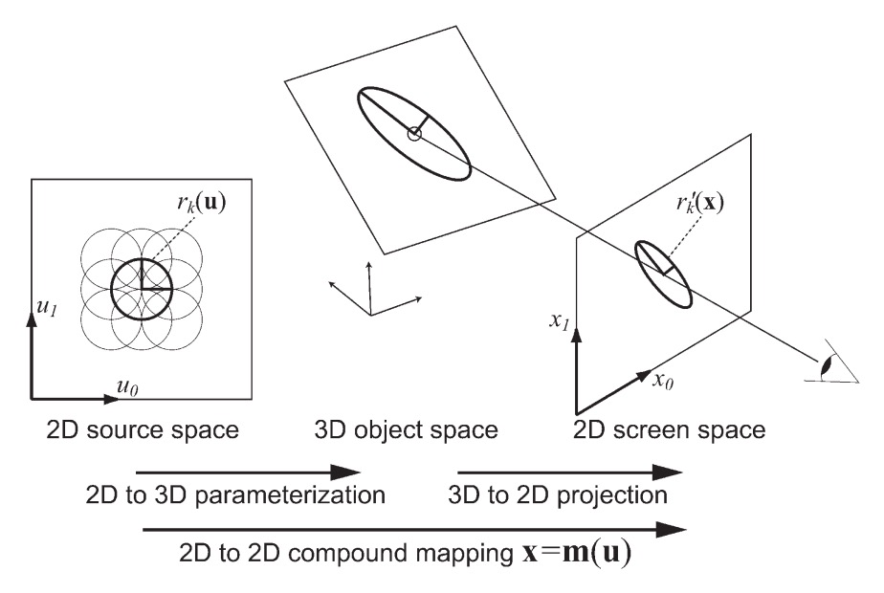

e.g., Texture
2D to 2D compound inverse mapping $u=m^{−1}(x)$

Slide 11
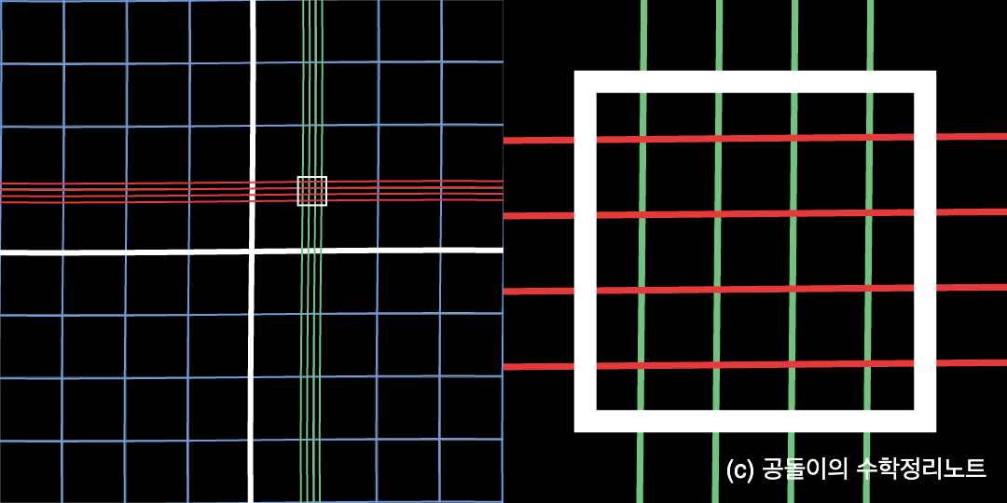
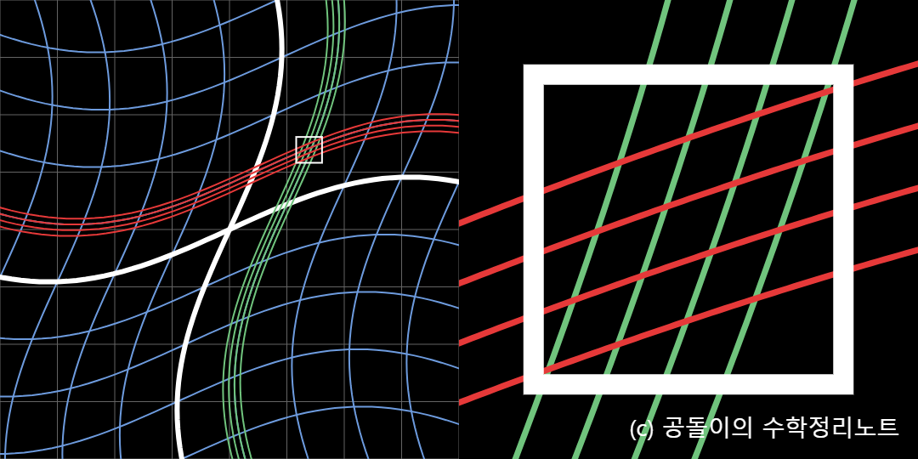
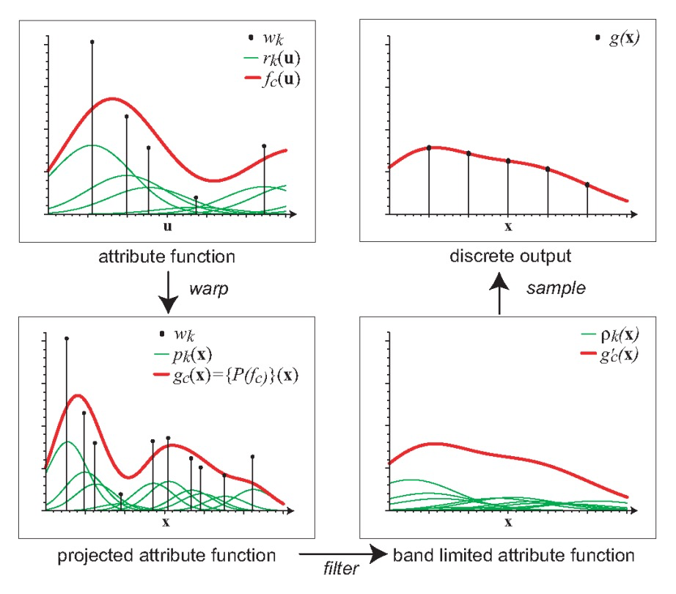

Slide 12


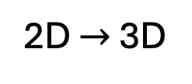
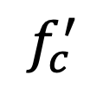
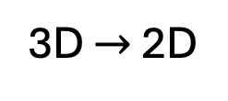

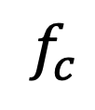




Volume Density
$$ρ$$
$$φ$$
$$f_{c}$$
$$x$$
3D $→$ 2D
$$ρ^{−1}$$
$$φ^{−1}$$
$$f_{c}^{′}$$
$$x$$
2D $→$ 3D

Slide 13

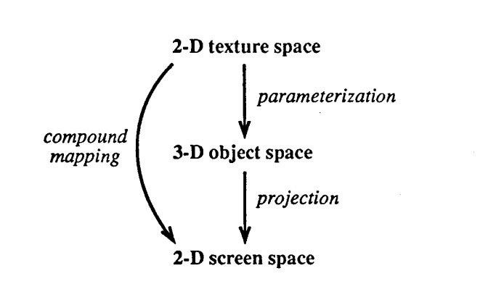
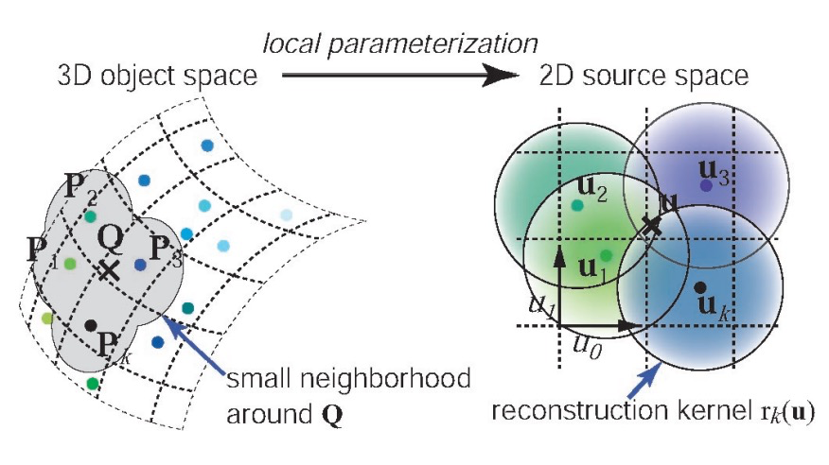

Slide 15
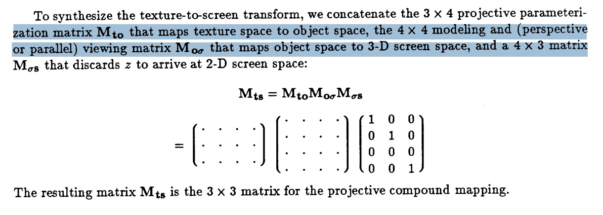


Slide 16
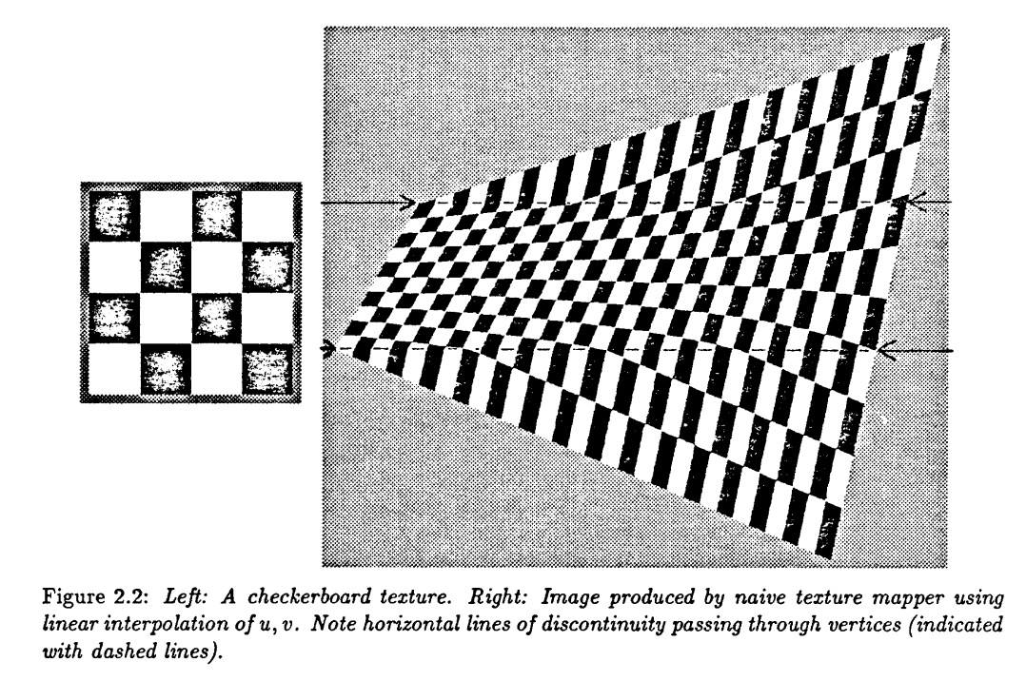
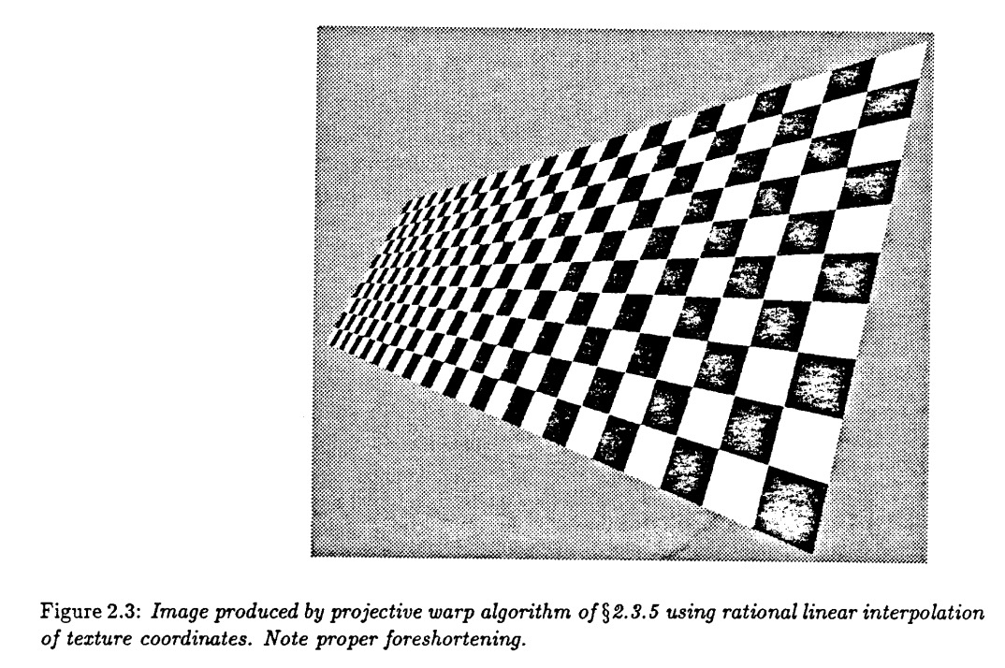
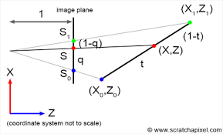
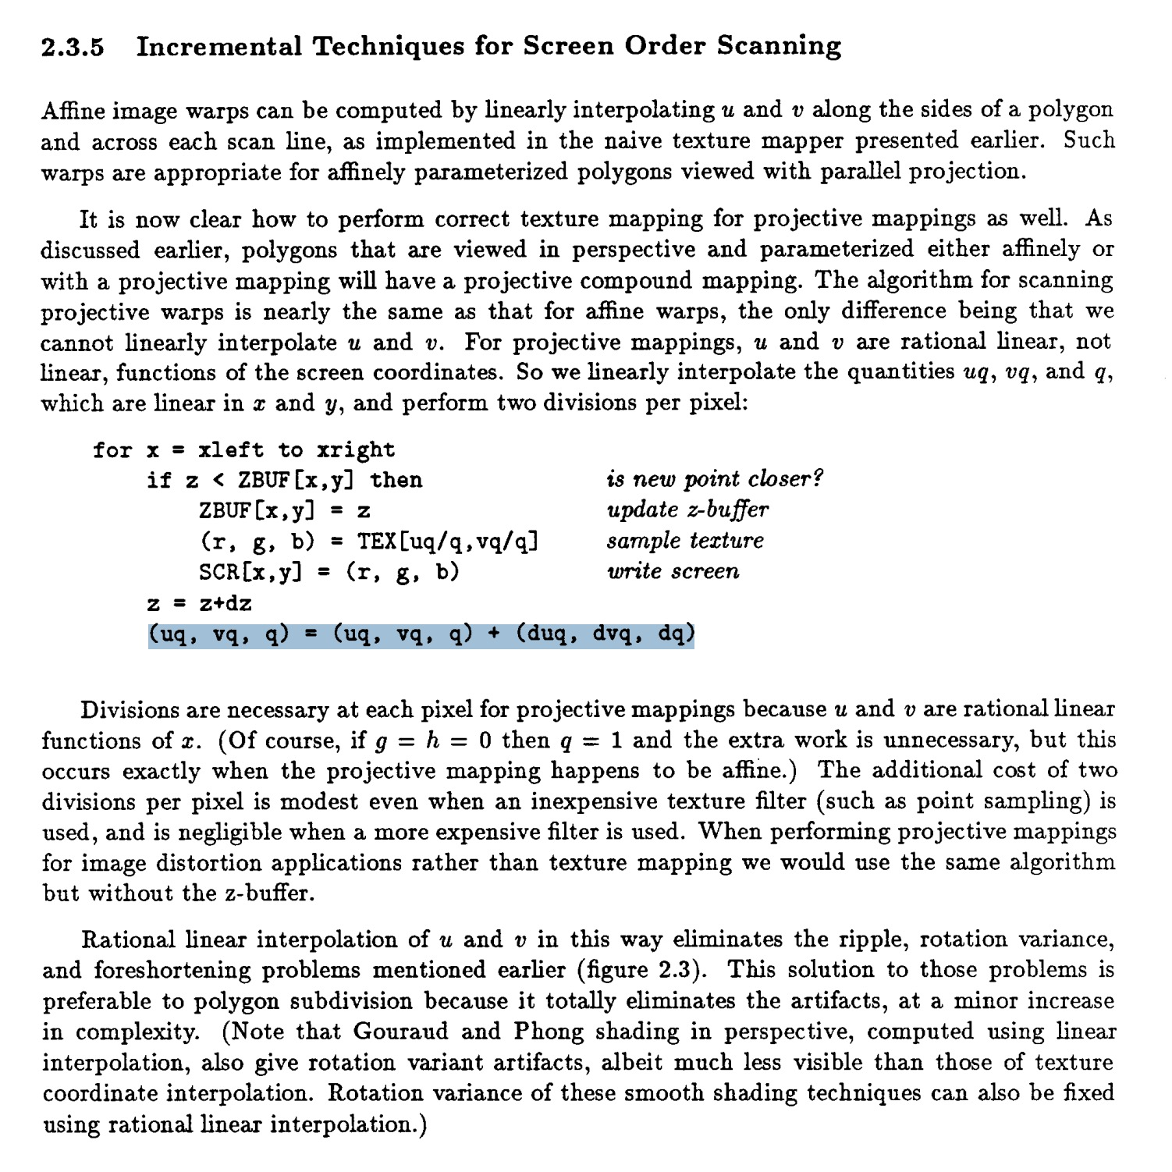
실제 결과
기대 결과

